Slide 1
Web Authoring
Task 1– Set the style sheet so each table has:
Create a new CSS called table.CSS
Table CSS
Table | Height: 200px, Width 400px
 | External Borders – 3px, Red
 | Internal Borders – 2px, Blue
 | Cell Padding to the top and bottom of 10px
 | All Borders Solid
 | Collapsed Borders
Tbody | Green Background
THead (Header) | Yellow Background Text: Red, Italic and Centre Aligned
TFoot (Footer) | Red Background Text: Blue and Right Aligned
Set your name as a comment

Slide 2
Web Authoring
Task 2 – Create Table
Create a new html file called Tables.htm and attach the style sheet created in step 1. Create the tables shown below and apply appropriate labels.
Table 1
Header
Footer
Table 2
Header
Footer

Slide 3
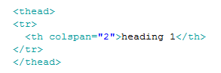
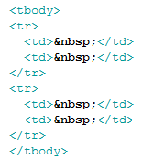
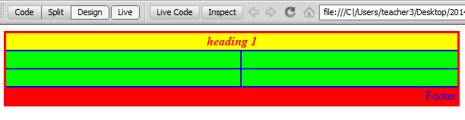

Web Authoring
Task 3: Create the HTML attributes for the table header, footer and body
Preview the table in Live View.

